Slide 1

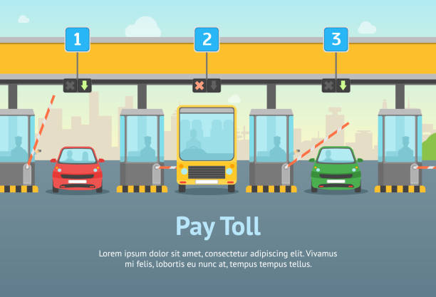
Quick Toll
An Automatic Toll System
Nitish Kumar – 2k19/IT/093
Mehul Jain – 2k19/IT/078
Github:https://github.com/Nitish9711/QuickToll

Slide 2

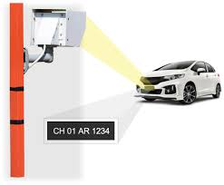
Our Solution
Problem 1
Automatic Number Plate Recognition
Long queues at toll stations
In this a camera will capture the image of the vehicle.
Identify the type of vehicle and number plate of the vehicle.
Increase the Toll amount corresponding to that vehicle
Problem 2
Problems
Human Resource required around the clock
Human Resource required around the clock
Design a low cost and effective system
Attain complete automation of toll booths
Reduce waits at toll stations
Create a facility to pay online
Our Objective

Slide 3


Object oriented Programming concepts Used:
Data Abstraction
Inheritance
Constructors
Data encapsulation
Different types of class functions
1. Accessor functions
2. Mutator functions
Exception Handling
2019

Slide 4

Toll class
Core classes Used
Handles all the functions from using calling required functions to updating database
2019
Plate_detector
Used to extract Vehicle number Plate the object
Extract Number
Extracting Number from the detected portion
Utility
Contains functions which are required throughout the program
Like accessing databse , sending mails, etc.

Slide 5

Process flow
Capture the vehicle image
User
Pass through model trained
First Time User
Detect the number plate in the image
Checking User exist or not
Enter Vehicle Number
Fill the vehicle Registration form
Crop the number plate image
Enter OTP
Process image for extracting Vehicle Number
Update databse
Pay Tax
Access the data corresponding to Vehicle number and increase toll tax details
Extract Number plate using pytesseract engine
Notify the user about toll tax via Email

Slide 6


Other Common libraries Used
1. requests
2. json
3. os
4. re
5. math
6. datetime
7. pymongo
REST APIs
OpenCage Geocoding API
Paypal sandbox Devlopers API
Databse
Mongodb
Extra Tools
Mongodb Compass
Tesseract OCR Engine
Programming language and tools used
Python
Libraries Used
For Number plate Extraction
1. Opencv
2. Pillow
3. smtplib
4. Scipy
5. Pytesseract
For Website Part
Flask
Flask_mail
sessions
2. Werkzeug
3. paypalrestsdk
PITCH DECK V 1.0

Slide 7

Algorithm Used For Training Our Model
How it Works?
Divide the Image into 13 x 13 Grid of cells. The size of these 169 cells vary depending on the size of input.
Each cell predicts a number of bounding boxes.
For each bounding box, the network also predics the confidence that the bounding box actually encloses an object , and the probability of the enclosed object being a particular class.
Remove low confidence boxes by NMS(non-maximum suppression)
YOLOv3 is the latest variant of a popular object detection algorithm YOLO – You Only Look Once. The published model recognizes 80 different objects in images and videos, but most importantly it is super fast and nearly as accurate as Single Shot MultiBox (SSD).

Slide 8
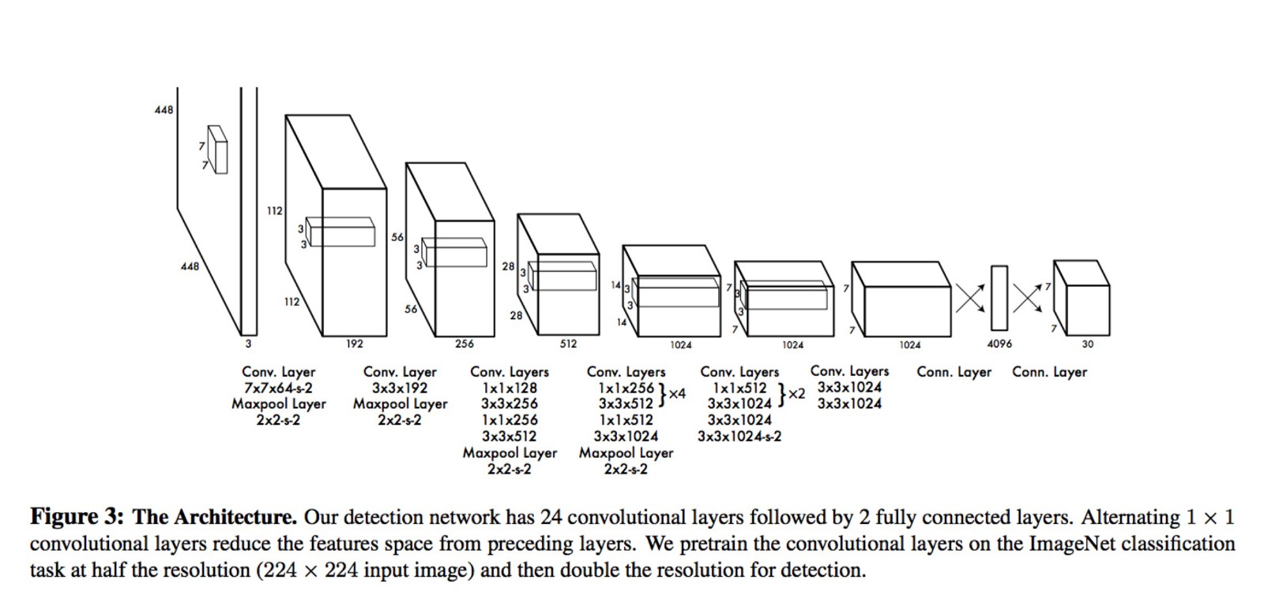
Yolo architecture

Slide 9
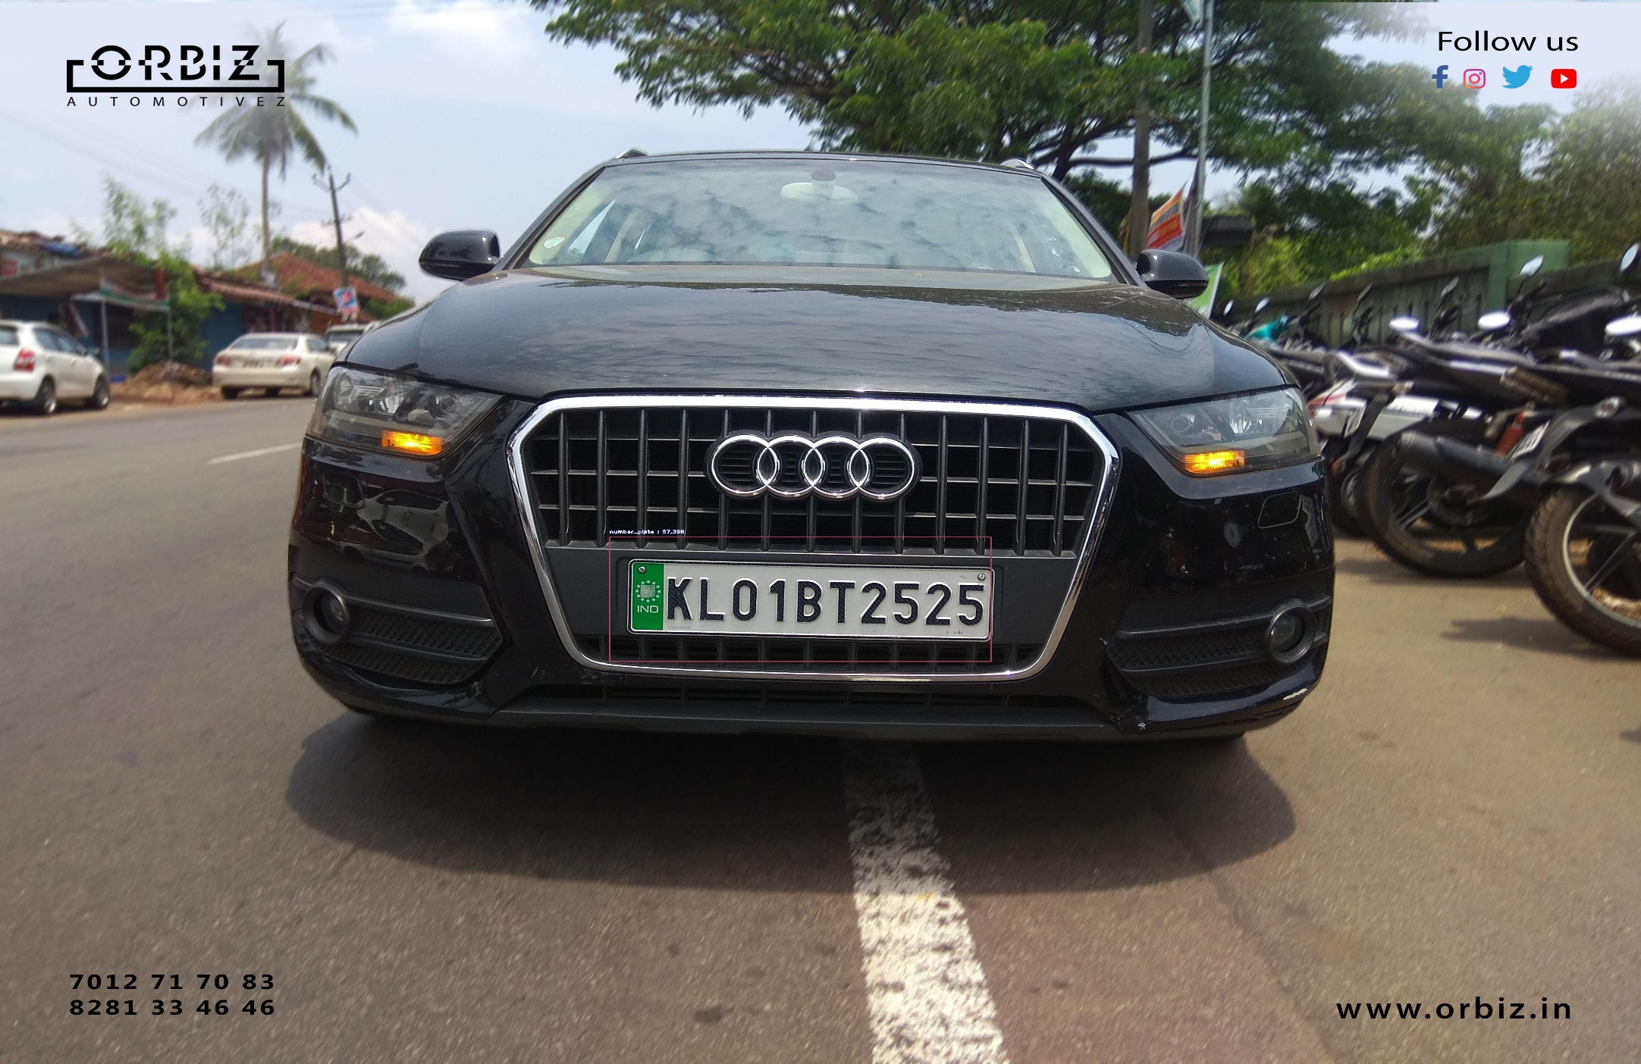
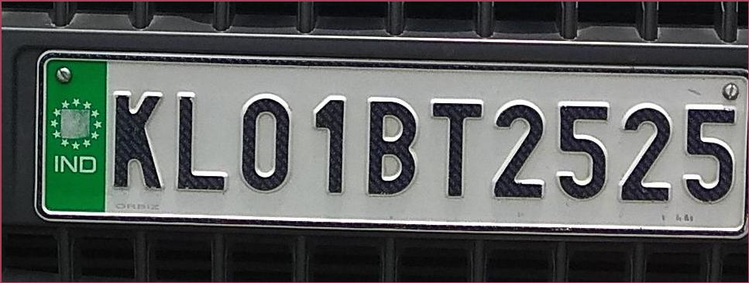
Number plate detection
Number Plate Detected
Number Plate Detected
Cropped Image

Slide 10
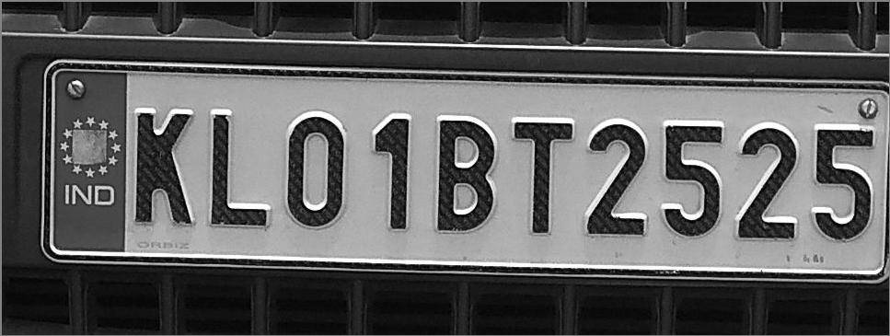
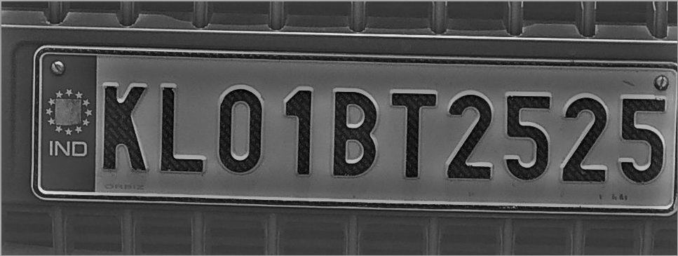
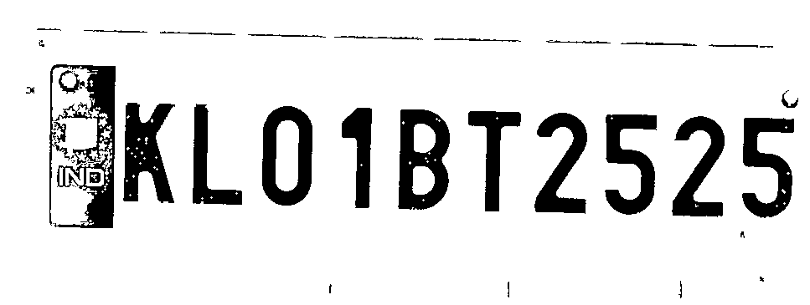
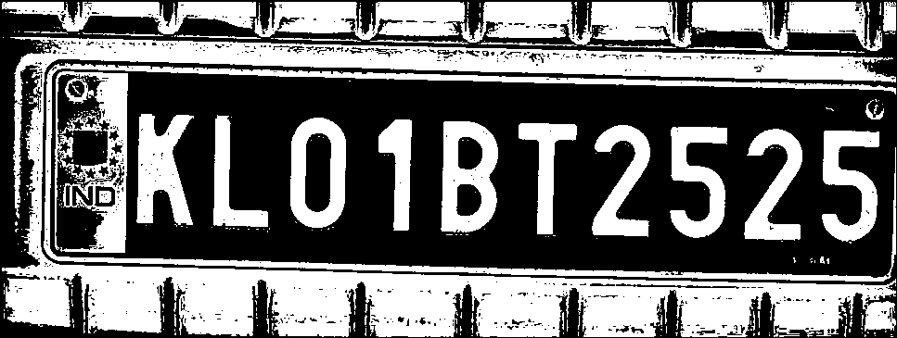
Number Plate Image Processing
1. Grey Scale Conversion
2. Contour Mapping
3. Black and White according to
threshold value(60)
4. Image Inversion

Slide 11
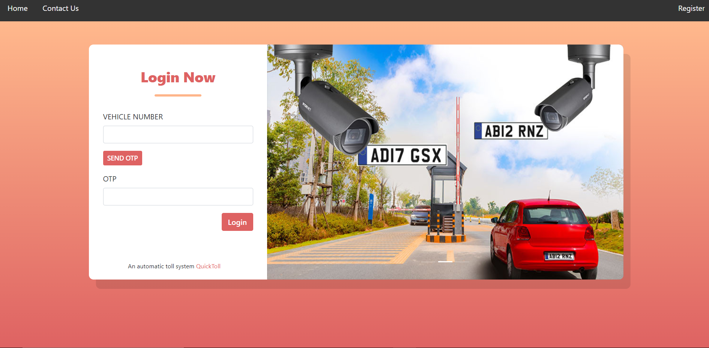
Website

Slide 12




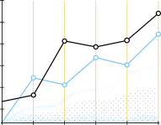















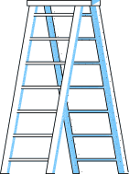







References:
https://docs.opencv.org/3.4/d6/d0f/group__dnn.html#ga3b34fe7a29494a6a4295c169a7d32422
https://opencv-tutorial.readthedocs.io/en/latest/yolo/yolo.html
https://towardsdatascience.com/non-maximum-suppression-nms-93ce178e177c
https://www.ijert.org/a-review-paper-on-automatic-number-plate-recognition-system-using-machine-learning-algorithms

